Slide 1

3D Transformations

Slide 2
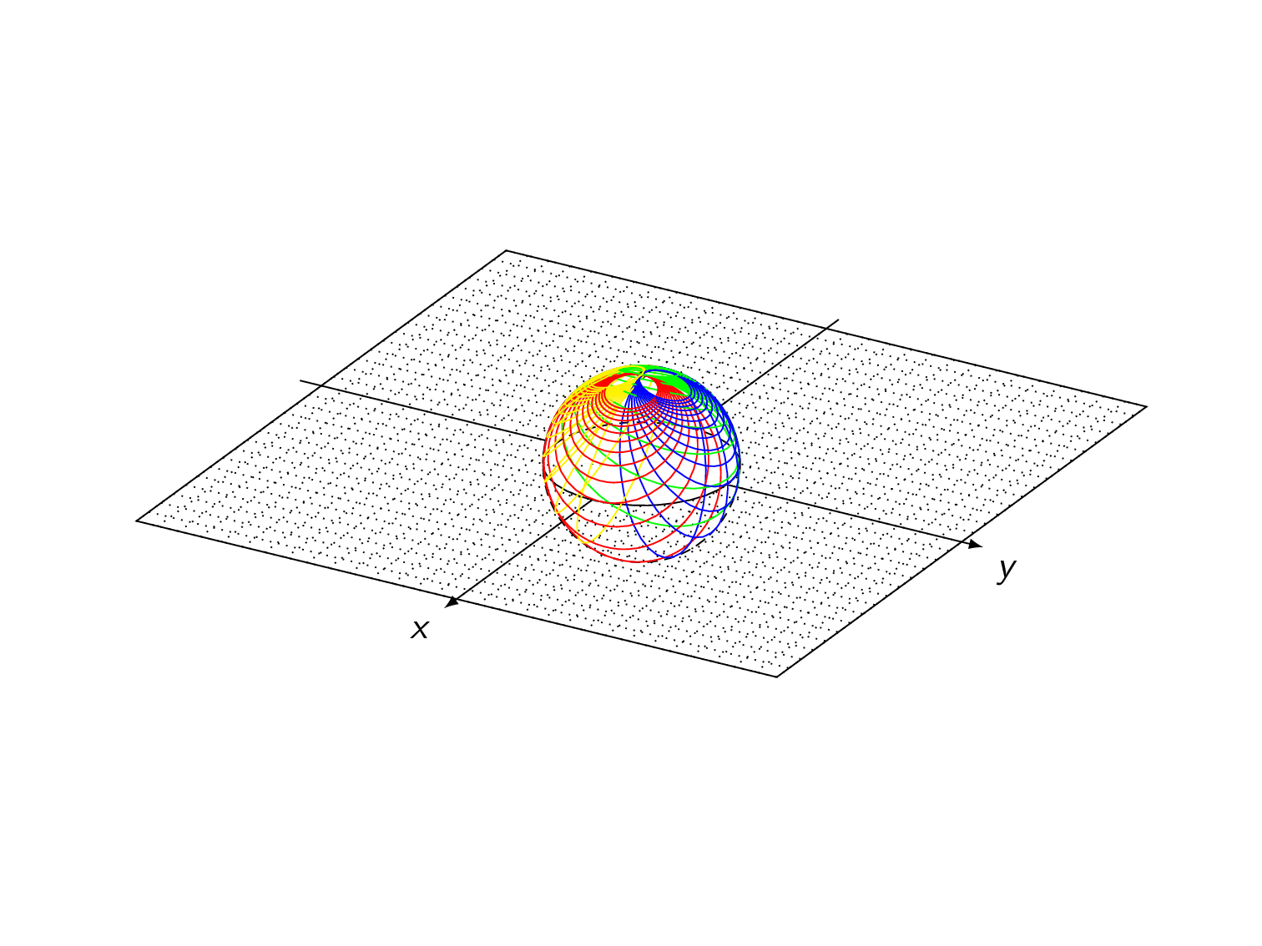
Introduction
3D transformations are essential in computer graphics and 3D modeling. They allow us to move, rotate, and scale objects in the three-dimensional space, enabling the creation of complex and realistic 3D scenes.

Slide 3
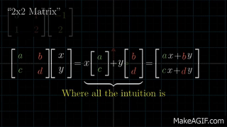
Linear Transformations and 3 by 3 Matrices
Linear transformations are fundamental operations in 3D computer graphics that alter the position, orientation, or size of objects in a scene. These transformations include translation, rotation, scaling, and shearing.
The matrix structure helps represent how points or vectors in 3D space are transformed.

Slide 4
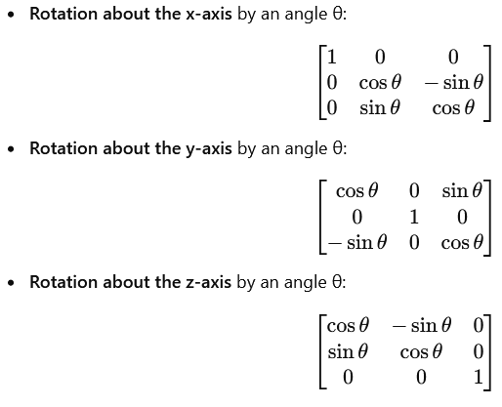
1. Rotation using 3x3 Matrices
In 3D, rotation can occur about any of the three principal axes: the x-axis, y-axis, or z-axis. Each axis has its own specific 3x3 matrix for performing the transformation:

Slide 5
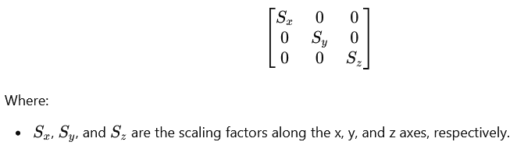
2. Scaling using 3x3 Matrices
Scaling changes the size of an object along the x, y, and z axes. A 3x3 scaling matrix looks like this:

Slide 6
3. Applying Transformation
To apply a linear transformation (rotation or scaling) to a point in 3D space, the point's coordinates are multiplied by the 3x3 matrix corresponding to the transformation.
For example, if we have a point P(x,y,z) and a transformation matrix T, the new point P′ after the transformation is computed as:
P′=T×P

Slide 7
4. Combining Transformation
Multiple transformations can be combined by multiplying their corresponding matrices. For instance, to rotate an object and then scale it, you would multiply the rotation matrix by the scaling matrix, in the order the transformations are applied.

Slide 8


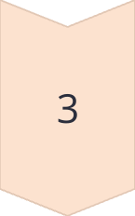
Translation: Moving Objects in 3D Space
Displacement
Translation moves an object to a new position in 3D space without changing its orientation or size.
Additive
The translation vector is added to the object's coordinates to determine its new position.
Representation
Translation can be represented using a 4x4 transformation matrix.

Slide 9
Rotation: Orienting Objects in 3D Space
In 3D graphics, rotation is a fundamental transformation used to orient objects within a 3D space. Rotation adjusts an object’s orientation by turning it around one or more of the three coordinate axes (x, y, and z) in a defined direction and by a specified angle.
1
Axis-Angle
X-axis Rotation: Rotates the object around the x-axis, affecting the y and z coordinates.
Y-axis Rotation: Rotates the object around the y-axis, affecting the x and z coordinates.
Z-axis Rotation: Rotates the object around the z-axis, affecting the x and y coordinates.

Slide 10
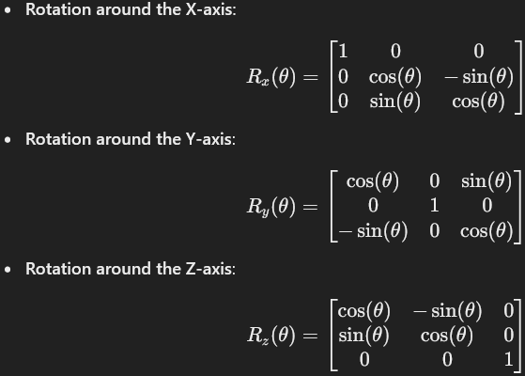
Rotation: Orienting Objects in 3D Space
2
Rotation Matrix
To achieve rotation, 3x3 matrices (or 4x4 for homogeneous coordinates) are used. These matrices are multiplied by the coordinates of points on the object to rotate it.

Slide 11
Rotation: Orienting Objects in 3D Space
3
Composite Rotation
For rotations around more than one axis, composite rotations are created by multiplying individual rotation matrices in the desired order.

Slide 12
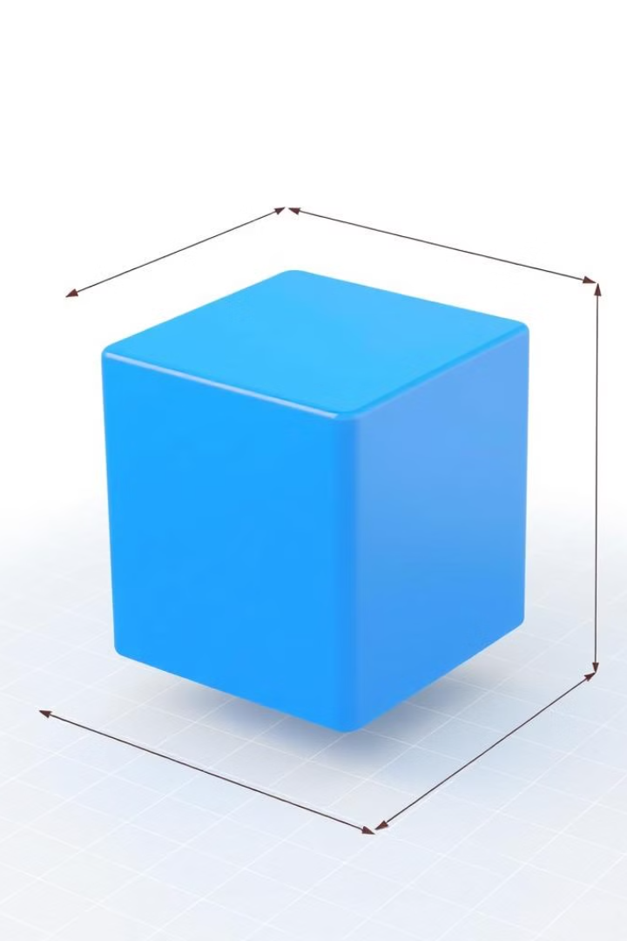
Scaling: Resizing Objects in 3D Space
1
Non-Uniform Scaling
2
Representation
Scaling can be applied independently along each of the three dimensions, allowing for non-uniform resizing.
Scaling is represented using a 4x4 transformation matrix with the scaling factors on the diagonal.
3
Preserving Proportions
Uniform scaling means making an object bigger or smaller by the same amount in all directions, so its shape stays the same.

Slide 13
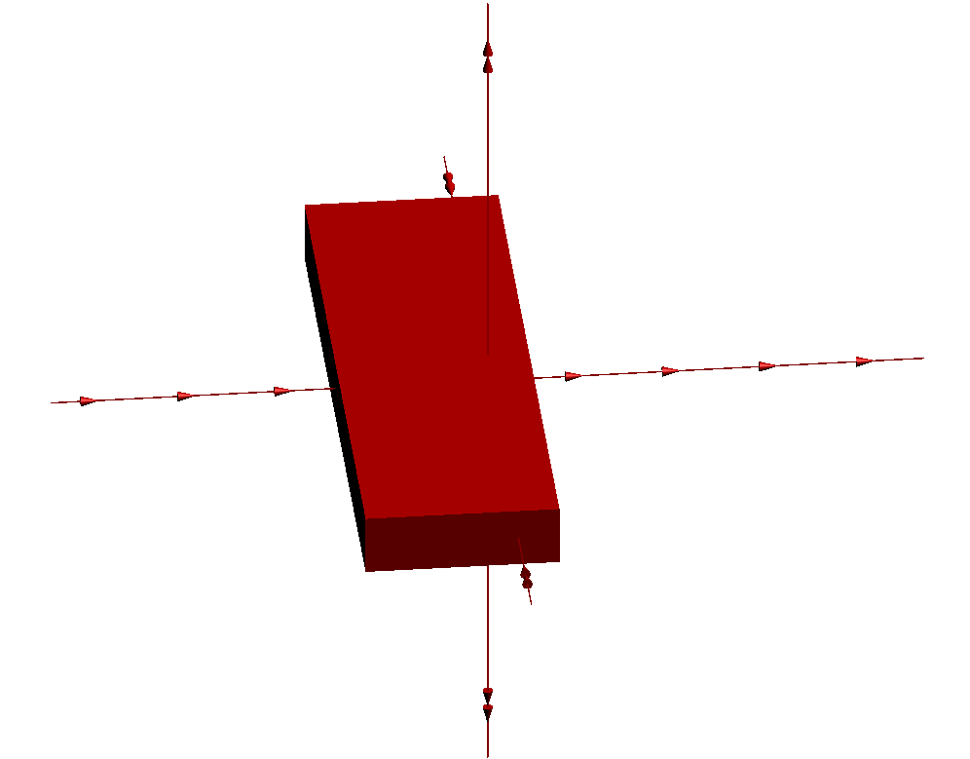
Affine Transformation
In 3D transformations, Affine transformations refer to a class of transformations that include scaling, rotation, translation, and shearing. These transformations preserve straight lines and relative distances between points on those lines but may change the angles between lines and the object's size and orientation.

Slide 14
Affine – Points and Frames
Points: In 3D space, a point is defined by its coordinates, usually as (x,y,z). When applying affine transformations, the position of the point is altered based on the type of transformation.
Frames: A frame in 3D space is like a local coordinate system defined by an origin and three perpendicular axes (usually x, y, and z). The frame helps describe the position and orientation of objects in space. Affine transformations change not only the position of points but also the entire coordinate frame.

Slide 15
Affine Transformations and 4 by 4 Matrices
Affine transformations in 3D computer graphics include operations like translation, scaling, rotation, and shearing. These transformations are essential for moving and manipulating objects in 3D space. To apply them efficiently, we use 4x4 matrices.
Why Use 4x4 Matrices?
In 3D transformations, 3x3 matrices are limited to linear transformations (scaling, rotation, shearing), but they cannot handle translation. To include translation in the transformation process, we expand to 4x4 matrices, which allow all types of affine transformations to be combined and applied using matrix multiplication.

Slide 16
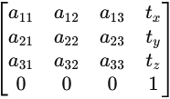
Affine Transformations and 4 by 4 Matrices
4x4 Matrix Structure
A typical 4x4 matrix used in affine transformations looks like this:
The upper-left 3x3 part of the matrix (with elements a_{ij​}) handles rotation, scaling, and shearing.
The last column [t_{x}, t_{y}, t_{z}]^{T} handles translation (moving an object in the x, y, and z directions).
The bottom row [0,0,0,1] allows for the use of homogeneous coordinates, which is key for managing translation and perspective transformations.

Slide 17
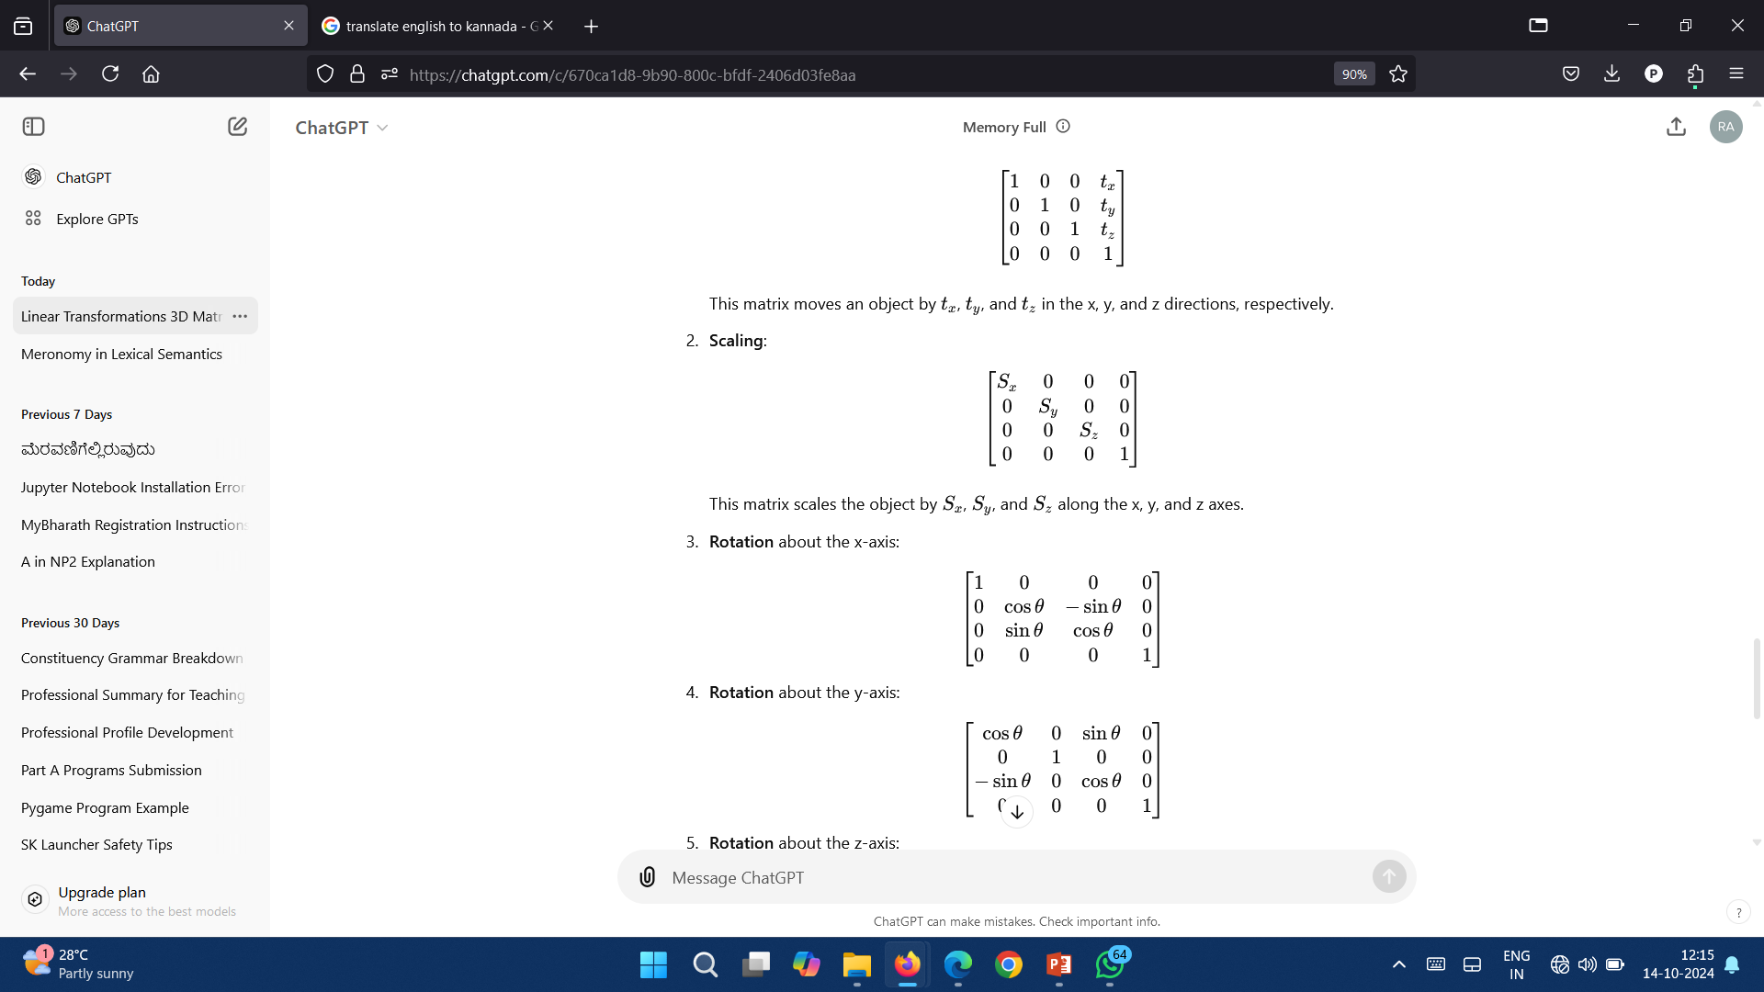
Affine Transformations and 4 by 4 Matrices
1. Translation
A typical 4x4 matrix used in affine transformations looks like this:
This matrix moves an object by t_{x}​, t_{y} and t_{z}​ in the x, y, and z directions, respectively.
This matrix scales the object by S_{x}​, S_{y} and S_{z} ​ along the x, y, and z axes.
2. Scaling

Slide 18
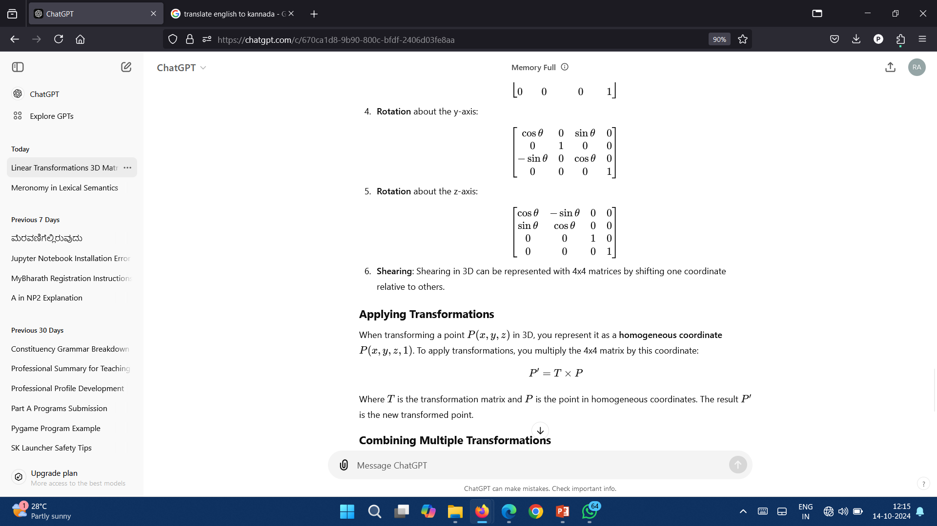
Affine Transformations and 4 by 4 Matrices
3. Rotation about the x – axis
4. Rotation about the y – axis
5. Rotation about the z – axis

Slide 19
Applying Transformations
When transforming a point P(x, y, z) in 3D, you represent it as a homogeneous coordinate P(x, y, z, 1). To apply transformations, you multiply the 4x4 matrix by this coordinate:
P′ = T × P
Where T is the transformation matrix and P is the point in homogeneous coordinates. The result P′ is the new transformed point.

Slide 20
Combining Multiple Transformations
You can combine multiple affine transformations by multiplying their corresponding 4x4 matrices. For example, to apply a rotation followed by a translation, you multiply the rotation matrix by the translation matrix:
T_{combined} = T_{translation} × T_{rotation}

Slide 21
Applying Linear transformations to points in 3d transformation
Applying linear transformations to points in 3D transformations means manipulating the position, size, or orientation of points (or objects) in 3D space using mathematical operations like scaling, rotation, and shearing. These operations are represented using 3x3 matrices, which are applied to the coordinates of points in 3D space.

Slide 22
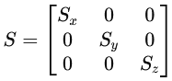
Applying Linear transformations to points in 3d transformation
Key Linear Transformations
Scaling: Scaling changes the size of an object by stretching or shrinking its coordinates. The transformation matrix for scaling is:
S_{x}​, S_{y}​, and S_{z}​ represent the scaling factors along the x, y, and z axes.
To apply scaling, multiply the scaling matrix by the point's coordinates:
P′ = S × P
This changes the point's position based on the scaling factors.

Slide 23
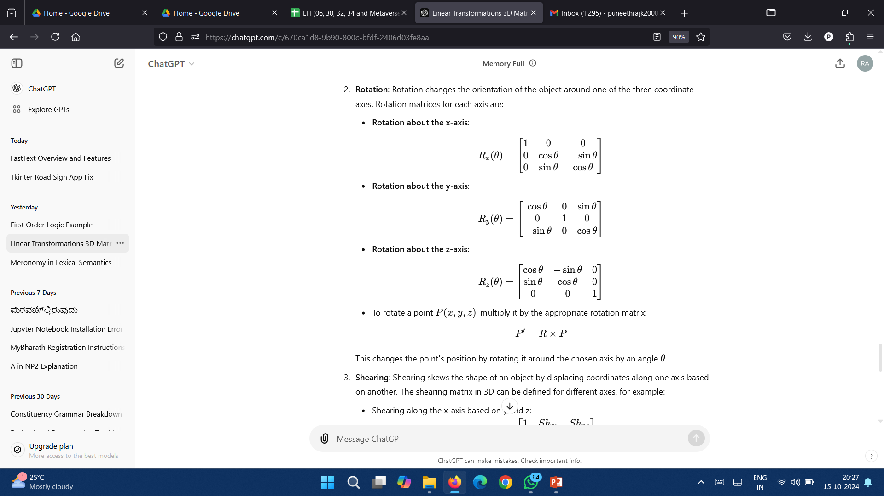
Applying Linear transformations to points in 3d transformation
Key Linear Transformations
Rotation: Rotation changes the orientation of the object around one of the three coordinate axes. Rotation matrices for each axis are:
Rotation about the x-axis:
Rotation about the y-axis:
Rotation about the y-axis:

Slide 24
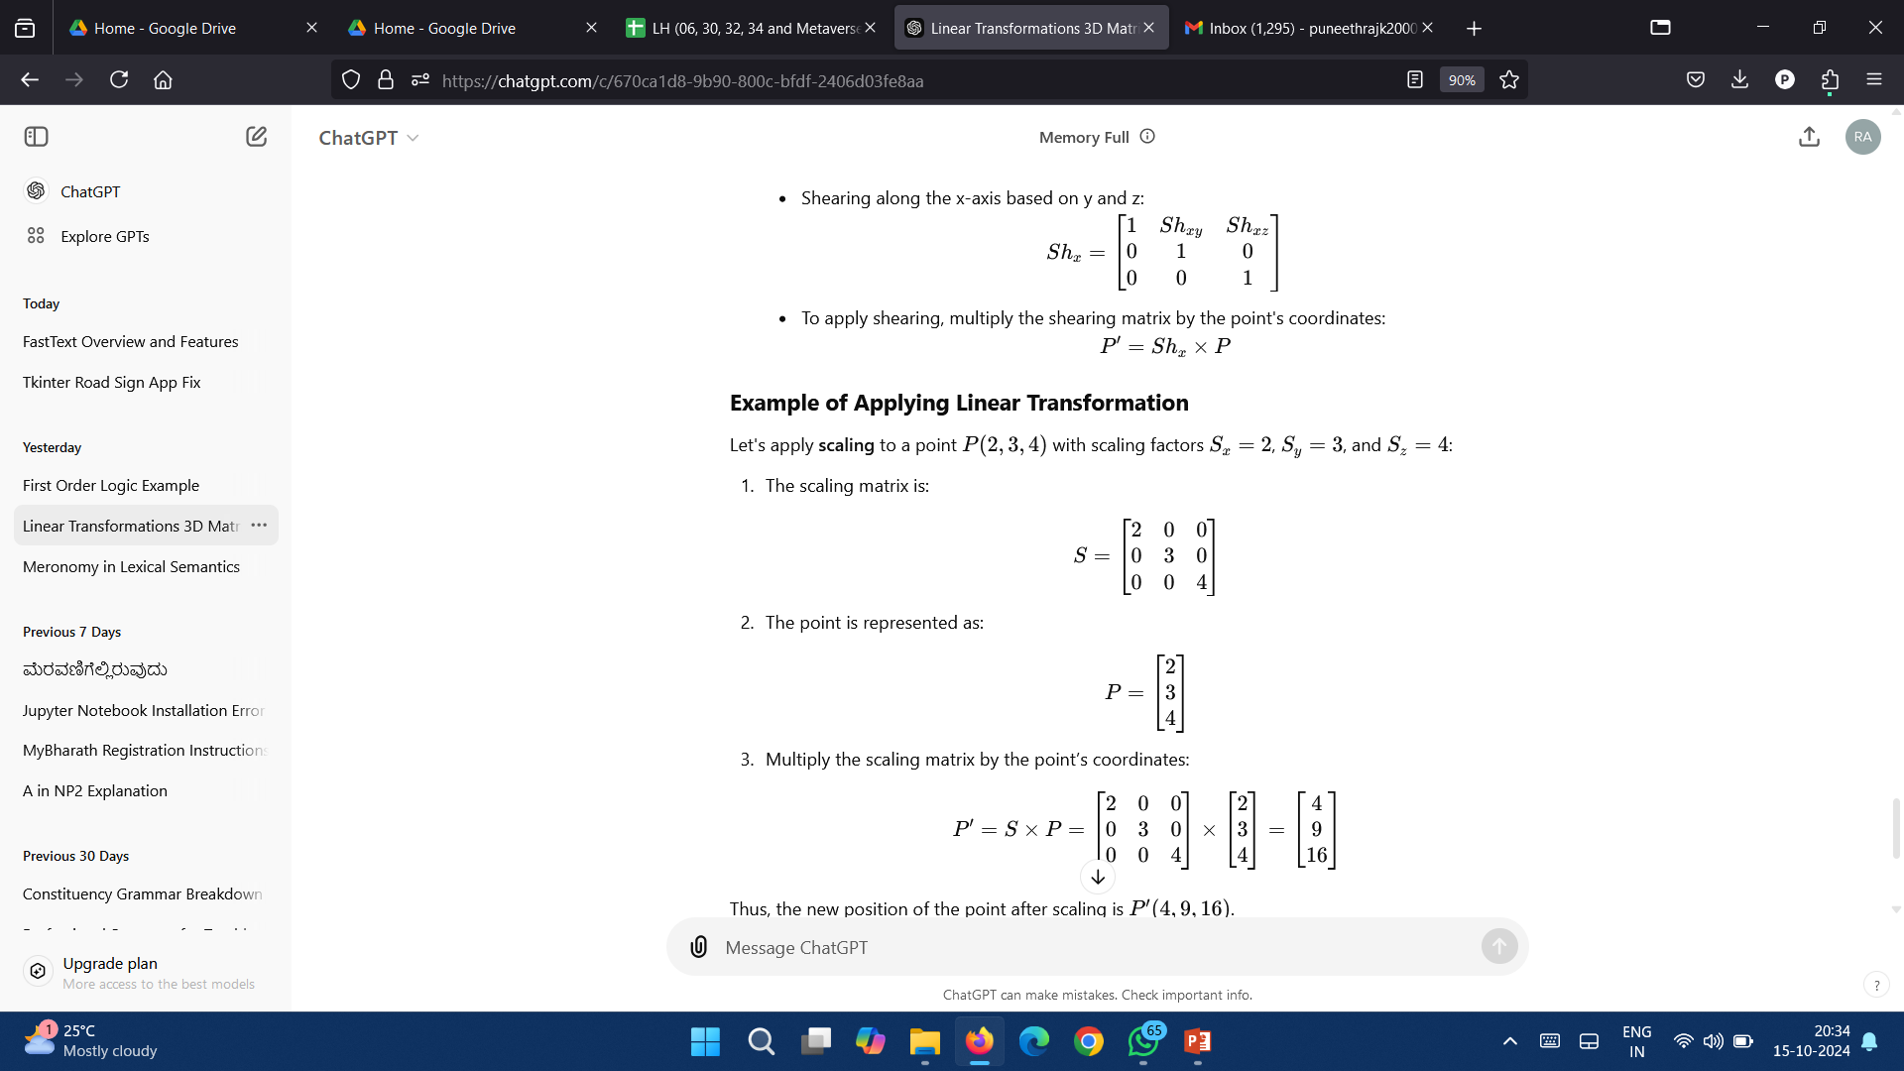
Applying Linear transformations to points in 3d transformation
Key Linear Transformations
Shearing: Shearing skews the shape of an object by displacing coordinates along one axis based on another. The shearing matrix in 3D can be defined for different axes, for example:
Shearing along the x-axis based on y and z:
To apply shearing, multiply the shearing matrix by the point's coordinates:
P′ = Sh_{x} ​× P

Slide 25
Applying Linear transformations to points in 3d transformation
Example of Applying Linear Transformation
Let's apply scaling to a point P(2,3,4) with scaling factors S_{x} = 2, S_{y} = 3, and S_{z} = 4:
The scaling matrix is:
The point is represented as:
Multiply the scaling matrix by the point’s coordinates:
Thus, the new position of the point after scaling is P′(4, 9, 16).

Slide 26
Translations
Translation in 3D moves an object from one place to another by shifting it along the x, y, and z axes. For example, you can move a point or object left, right, up, down, or forward and backward.
Formula for Translation:
If a point has coordinates P(x, y, z), and you want to move it by some amounts t_{x}​, t_{y} and t_{z} along the x, y, and z axes, the new point after translation is:
P′ = (x + t_{x}, y + t_{y}, z + t_{z})
So, you just add the translation values to the original coordinates.

Slide 27
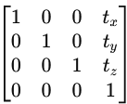
Translations
Matrix Representation:
To handle translation in 3D graphics, we use a 4x4 matrix:
This matrix allows us to easily combine translation with other transformations, like scaling and rotation.

Slide 28
Frames in Graphics
In 3D transformations, frames are coordinate systems used to describe positions and orientations of objects.
Key Frames:
World Frame: The main coordinate system for the entire scene.
Object Frame: Each object has its own local frame, defining its position and orientation relative to itself.
Camera Frame: Represents the view from the camera in the scene.
Transformations like translation, rotation, and scaling are applied to objects based on these frames, allowing objects to be positioned and moved within the scene.

Slide 29
Frames in Graphics
World Frame:
The global coordinate system for the entire 3D scene.
Everything in the scene is positioned relative to this frame.
Axes are typically labeled X, Y, and Z.
Eye (Camera) Frame:
Defines the view from the camera.
Everything is transformed into this frame to determine what the camera sees.
Helps render the scene from the camera's perspective.

Slide 30
Frames in Graphics
Moving things around
In 3D graphics, moving things around refers to applying transformations to objects to change their position, orientation, or size. The three main ways to move objects are:
Translation: Shifting an object from one place to another by moving it along the x, y, and z axes.
Rotation: Turning an object around an axis (x, y, or z), changing its orientation.
Scaling: Changing the size of an object, either uniformly (keeping proportions) or non-uniformly (stretching or shrinking along one axis).

